Slide 1
Congestion

Slide 2
What is Congestion
As Internet can be considered as a Queue of packets, where transmitting nodes are constantly adding packets and some of them (receiving nodes) are removing packets from the queue.
Consider a situation where too many packets are present in this queue (or internet or a part of internet), such that constantly transmitting nodes are pouring packets at a higher rate than receiving nodes are removing them.
This degrades the performance, and such a situation is termed as Congestion. Main reason of congestion is more number of packets into the network than it can handle. So, the objective of congestion control can be summarized as to maintain the number of packets in the network below the level at which performance falls off dramatically.

Slide 3
Cause of Congestion
At each node, there is a queue of packets for each outgoing channel
If packet arrival rate exceeds the packet transmission rate, the queue
size grows.
When the line for which packets are queuing becomes more than 80%
utilized, the queue length grows alarmingly
However, as traffic increases too far, the routers are no longer able to cope, and they begin to lose packets. This tends to make matter worse.
At very high traffic, performance collapse completely, and almost
no packet is delivered

Slide 4
Congestion Control Techniques
• Open loop: Protocols to prevent or avoid congestion, ensuring that the system (or network under consideration) never enters a Congested State.
• Close loop: Protocols that allow system to enter congested state, detect it, and remove it.

Slide 5
Load Shedding
Another simple closed loop technique is Load Shedding, it is one of the simplest and more effective techniques.
In this method, whenever a router finds that there is congestion in the network, it simply starts dropping out the packets.
There are different methods by which a host can find out which packets to drop. Simplest way can be just choose the packets randomly which has to be dropped. More effective ways are there but they require some kind of cooperation from the sender too.
For many applications, some packets are more important than others. So, sender can mark the packets in priority classes to indicate how important they are. If such a priority policy is implemented than intermediate nodes can drop packets from the lower priority classes and use the available bandwidth for the more important packets

Slide 6
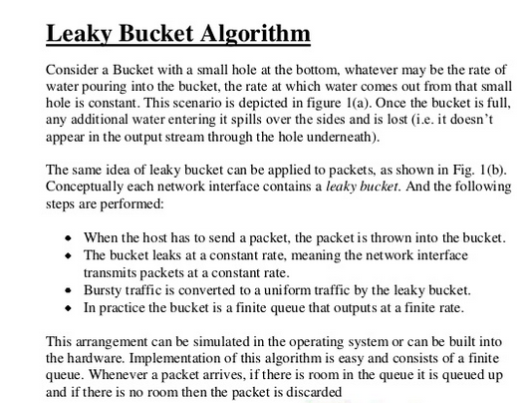

Slide 7
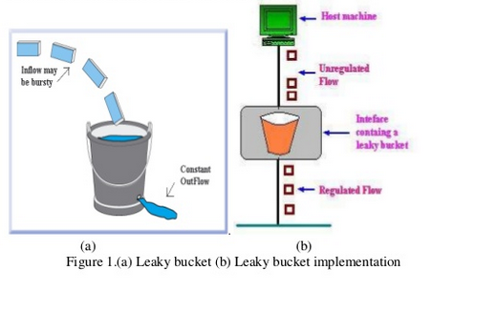

Slide 8
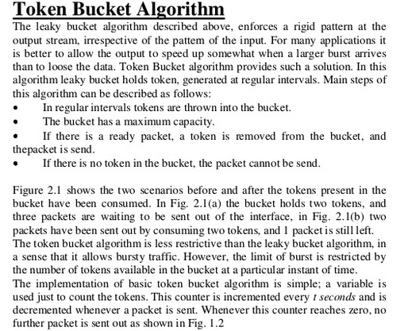

Slide 9
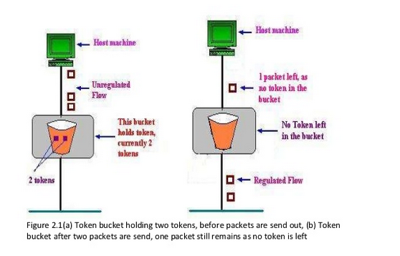

Slide 10
If you want to shine like sun first you have to burn like it. A.H

